Slide 1

Regression Analysis

Slide 2
Objectives
Fundamentals of regression analysis
Perform a T test, an ANOVA
Find the Pearson correlation, and perform regression analysis.
Regression Analysis

Slide 3
Regression
In terms of hypothesis testing, these tests measure the strength of relationship between two or more variables. And you have to run them independently
  Regression: the ultimate tool for hypothesis testing
  It can, arguably, replace
    T- test
    ANOVA
    Pearson Correlation tests
  Regression is available in most spreadsheets and all statistical software
Regression Analysis

Slide 4
Introduction to Regression models
You need a question to answer using regression model:
  Do male instructors get higher teaching evaluations than female instructors?
  Does beauty score decrease with age?
  Is there an association between an instructor’s looks and teaching evaluation score?
  Do good-looking professors get hired teaching evaluation scores?
Regression Analysis

Slide 5
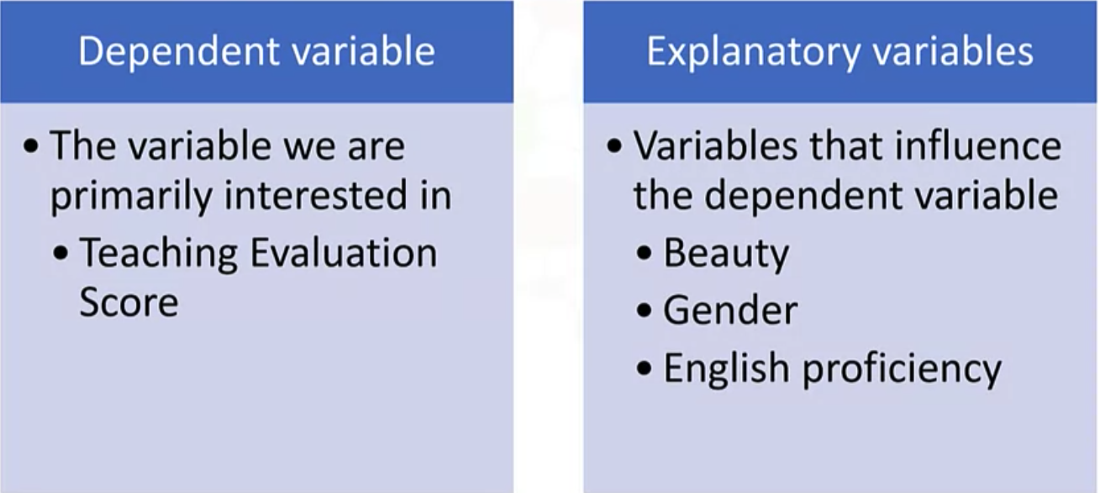
Regression
We focus now on the terminology of regression model. So there are two types of regression variables
Regression Analysis

Slide 6
The notation
The dependent variable is donated as Y. →This Y would be the teaching evaluation score.
The explanatory variables are denoted as Xs. → beauty, the gender and English language proficiency would be an X.
The underlying assumption is that Y is explained by X, that is teaching evaluation score Y is explained by X, that is the beauty score,
Or y is a function of x, which we write as Y is equal to function of X, that is, the teaching evaluation score is some function of beauty
Regression Analysis

Slide 7

The notation
Mathematically: y= f(x)
Statistically, if you run them, an estimate, a regression model,
Y is equal to some constant and then a weighting factor for the variable X and the error term.
An error term is whatever we cannot explain by the model, that goes into error term.
So Y is equal to, let say the constant is beta-naught plus some factor of weight, which is beta one for X plus the error term which we represent as epsilon.
Regression Analysis

Slide 8

The notation
If there are more than one explanatory variables:
Then Y is equal to beta naught, that's the constant, plus beta one, X_1. Beta one is the factor for one variable that could be beauty, plus beta two the other weight explaining another X_2 and other variables such as English language proficiency.
So the weight for English language proficiency would be beta two and plus the epsilon, which is the error term explaining
Regression Analysis

Slide 9
Teaching Evaluation Example
The model
  Teaching evaluation score= constant + weight( beauty) * beauty_score + errror
  Teaching evaluation score= 3.998 + 0.133 * beauty score + error
Error (E)
  The difference between the actual values and the forecasted values
  The difference between the actual teaching evaluation score and the predicted score from the model
Regression Analysis

Slide 10
Summary
Understand fundamentals of regression analysis
Perform a T test, an ANOVA
Find the Pearson correlation, and perform regression analysis.
Regression Analysis

Slide 11
Q & A
Regression Analysis

